Slide 1
Optimizing Recombinant Protein Titer Production in Escherichia coli Fermentations using Kalman Filters
Paul Okafor, MS Student
Data Science and Analytics
University of Oklahoma
April 19th, 2024
Notes:
-Take your time
-Get the words right
-Anunciate

Slide 2

Outline
Introduction
Data Variables
Data Exploration
Data Variants
Model Design
Results
Conclusion
Notes:
-Mammalian, Bacteria, Yeast, or Insect
-Mammalian cells take longer
-CHO is fascinating, but very common in recombinant protein production industry

Slide 3
Introduction
Escherichia coli (E. coli) in Biotechnology
Problem Definition
Rapid growth and simple nutrition
Broad applications: pharmaceuticals, enzymes
Easy genetic manipulation
Cost-effective approach
Notes:
Must format data first

Slide 4
Problem Definition
Process Optimization Challenges:
Rely on expert opinion
Hard to manage variables: temperature, pH, nutrients
Results in suboptimal yields & inefficiencies
Adoption of Machine Learning:
This research aims at the integration of interpretable machine learning models into decision support system
Notes:
Must format data first

Slide 5
Research Objectives
Identify the significant variables in the predictive models and determine correlation between variables
Build interpretable machine learning models
Integrate interpretable machine learning models into decision support system tool
Notes:
Must format data first

Slide 6
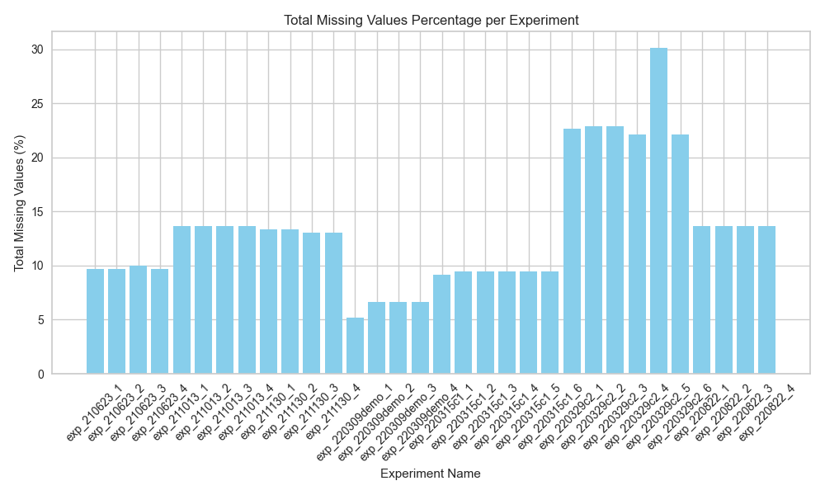
Data Ingestion
Cytovance experimental data
Given data via Microsoft Excel
7 “sheets” across 2 files
32 total batches
15 input variables
17 output variables
Issues during Ingestion
Invariant Input Variables
Titer values not recorded at each timepoint
Data format inconsistent ('±' and '%’)
Percentage of Missing value across batches

Slide 7
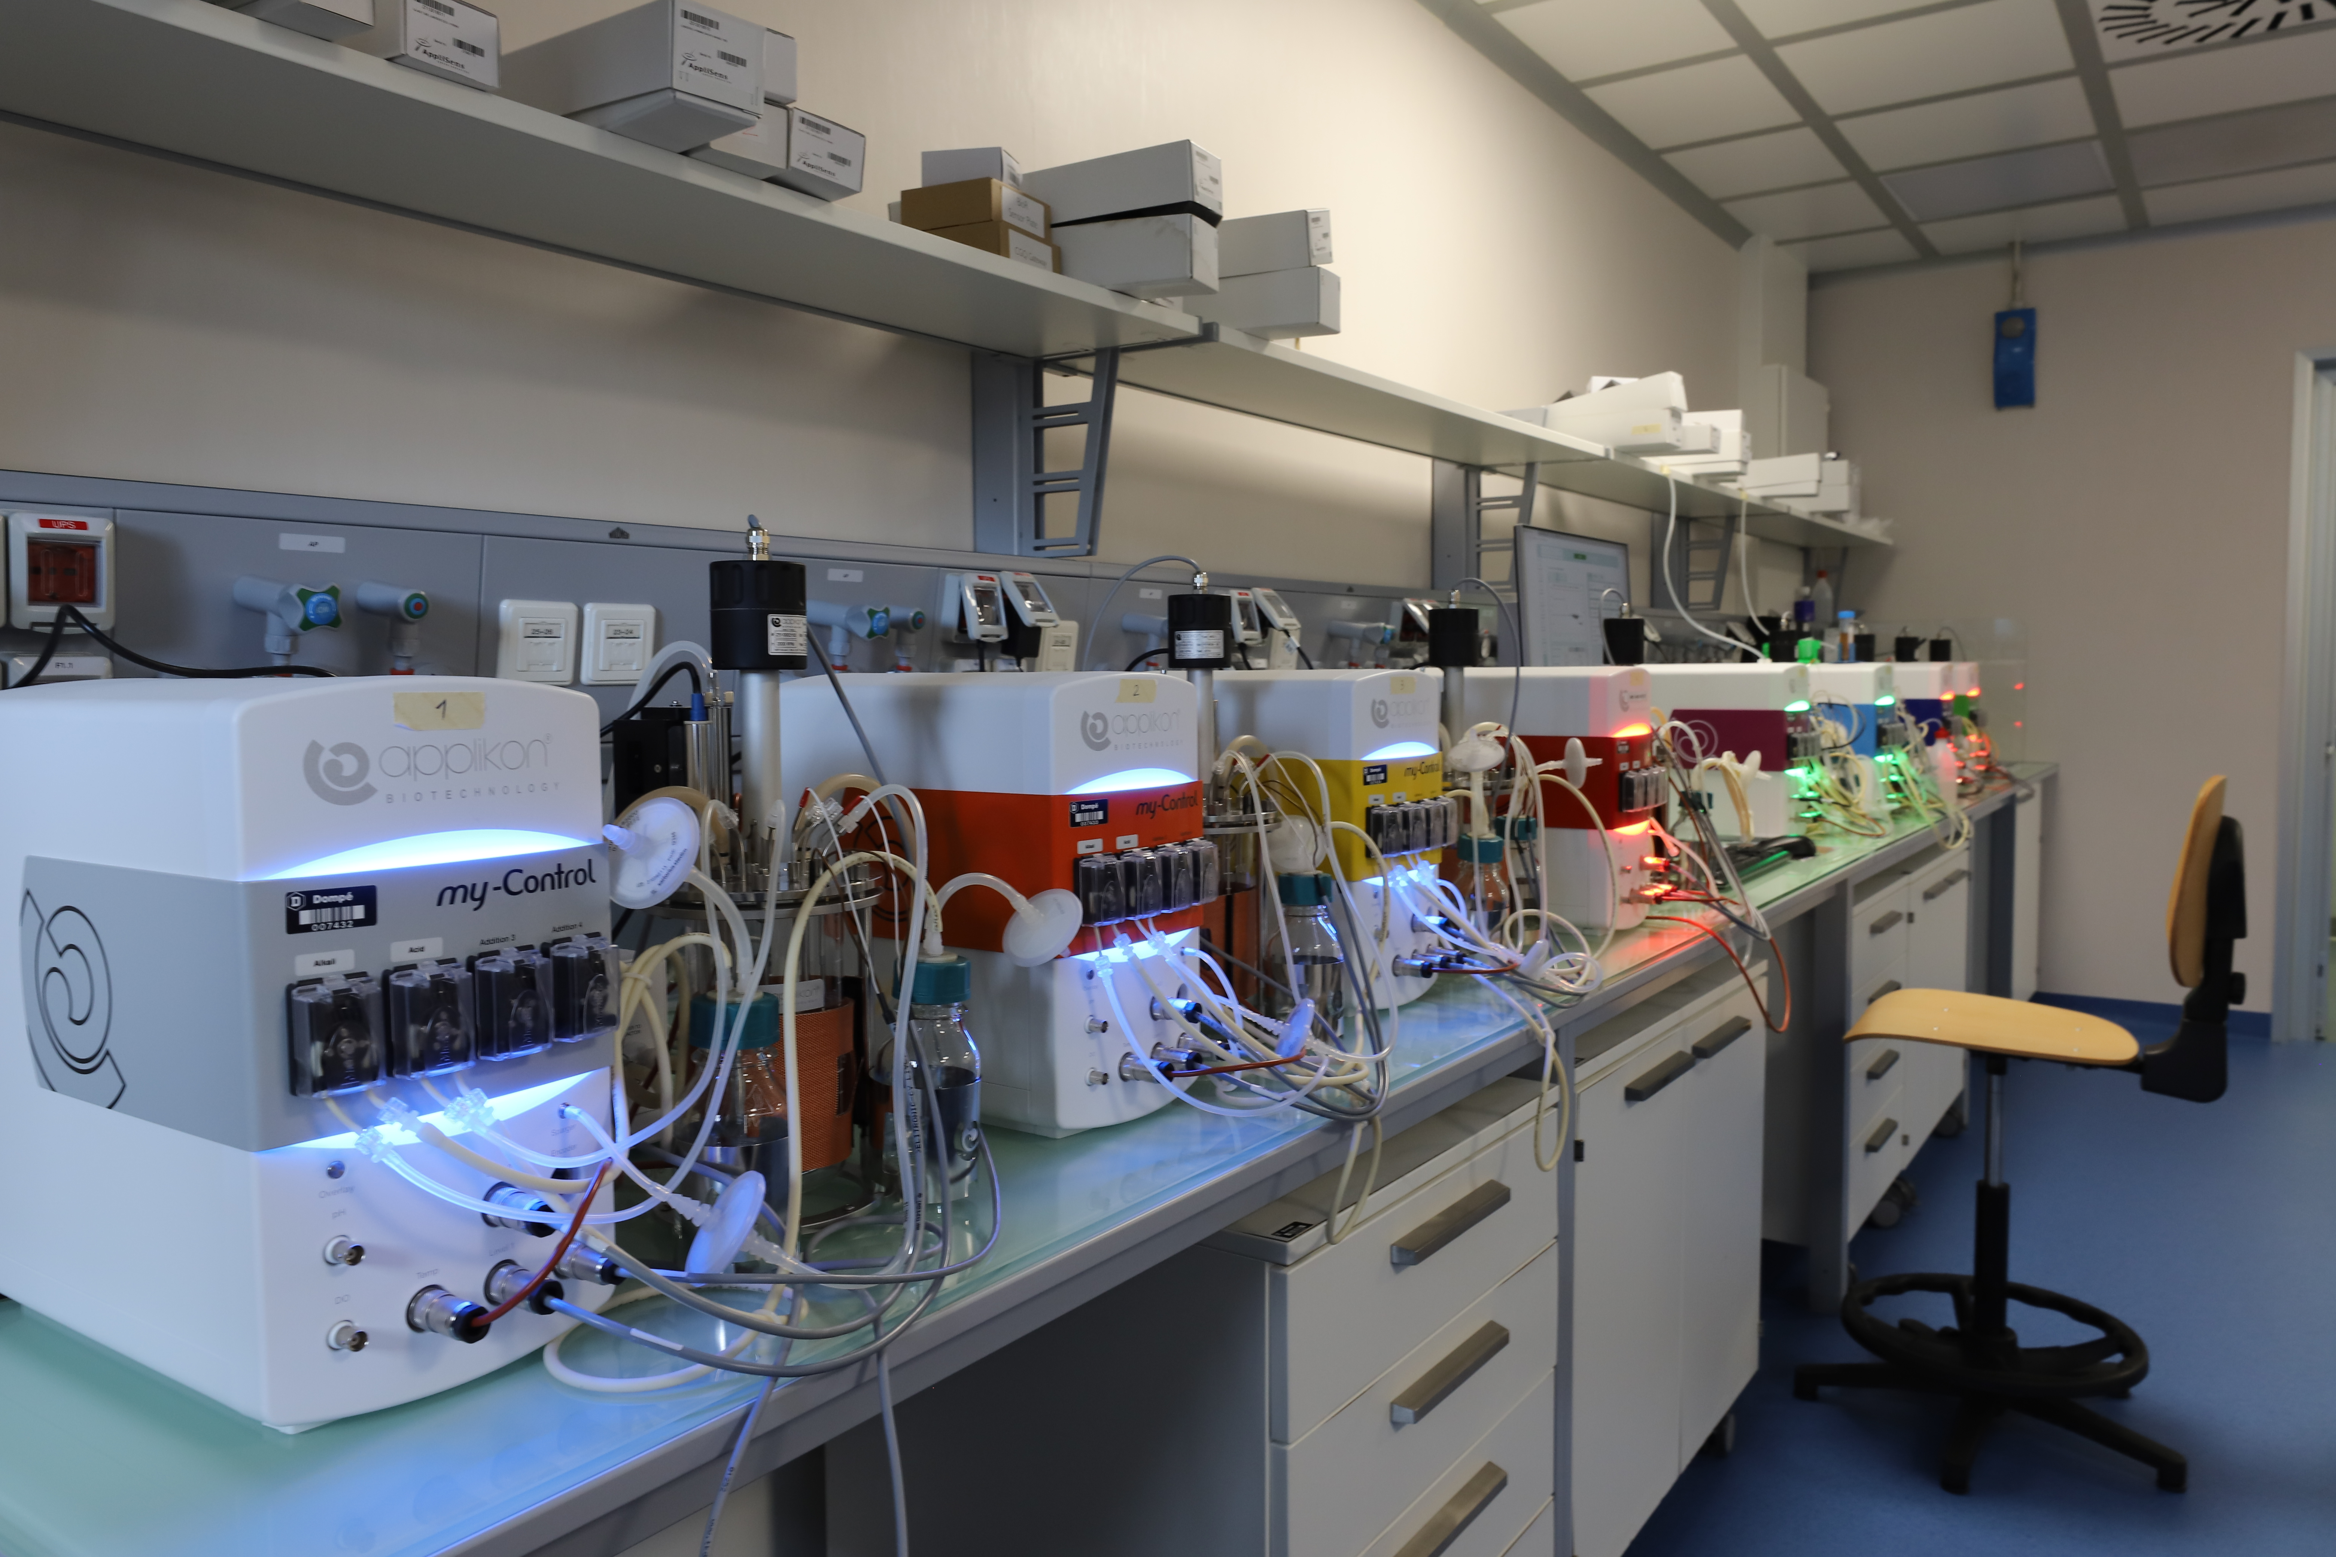
Data Variables
Input variables
Vessel Type (5L Fermenter)
Vessel Volume (500 ml)
Vessel Name (Ferm1)
Production Day (1 or 2)
Timepoint (0 - 48 hours)
Agitation (1185 rpm)
Dissolved Oxygen (100 %)
pH (6.3)
Gas Flow (5.0)
Air (100 %)
Oxygen (0)
Temperature (30 ºC)
Media Type (Media A)
Feed Type (Glucose)
Glucose Limit (0)

Slide 8
Data Variables
Output variables
These are the unique output variables:
Optical Density (OD600 (nm))
Wet Cell Weight (g/L)
Titer (mg/ml)
Glycerol (g/L)
Glucose (g/L)
Acetate (mmol/L)
Phosphate (mmol/L)

Slide 9
Data Exploration

Slide 10
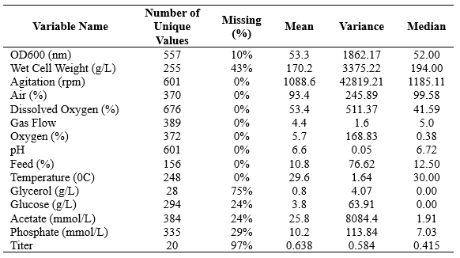
Data Exploration
Initial Data Preprocessing
Extract individual batches
Clean inconsistent data format ('±’ and ‘%’)
Rename appropriate columns
Standardize column order
Data quality report
Titer values is the target variable
Inputs Data Quality Report
Notes:
Must format data first

Slide 11
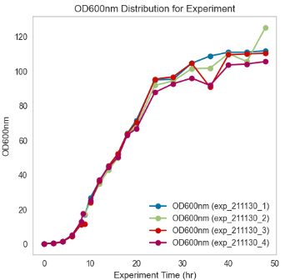
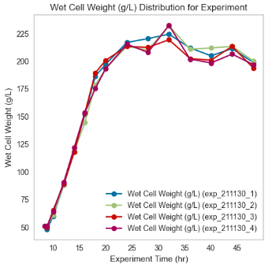
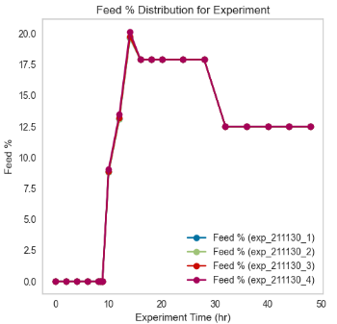
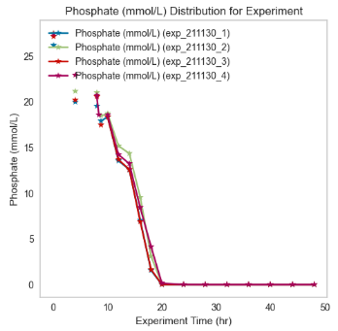
Data Exploration
Time series plots of key variables
The feed contains 50% glucose solution
When Acetate level > 5mmol/L, we add more feed
Protein expression levels performed poorly for batches in 220329c2, and 220315c1

Slide 12
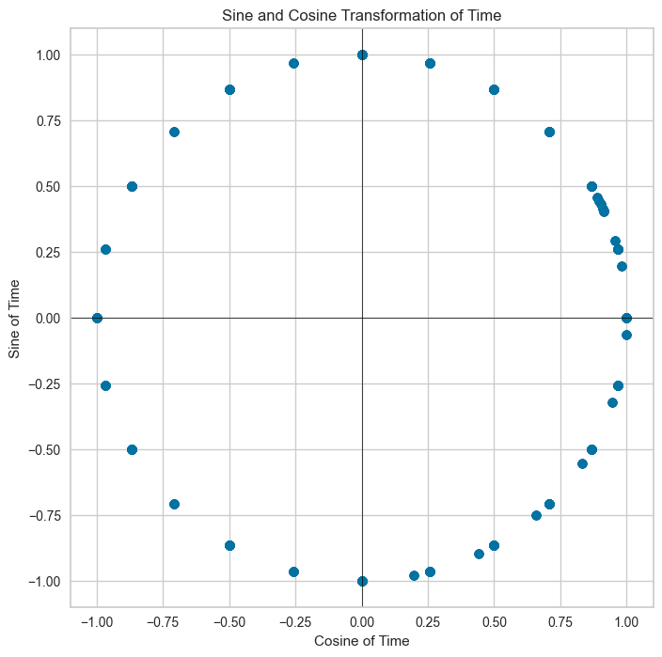
Time as a Variable – Fourier Series
Captures Cyclical Nature: Maps linear time to a circle, preserving cyclical patterns like days in a week or hours in a day (Time = 48 hours)
Sine & Cosine Functions: Create two dimensions, ensuring continuity (e.g., midnight close to 11 PM)
Enhances Analysis: Improves pattern recognition in cyclical data for time series forecasting and seasonal trends

Slide 13
Model Design

Slide 14
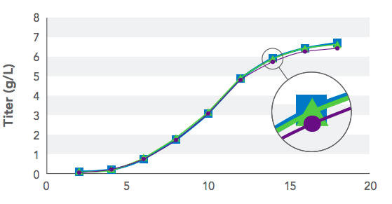
Model Approach: Kalman Filter for Titer Imputation
Titer imputation is critical for optimizing recombinant protein titer production in E. coli fermentations.
Data Challenge: Titer values were recorded only at 48 hours for 16 of 32 batches, unlike other variables tracked every 2 hours.
Kalman Filter Choice: Ideal for datasets with intermittent observations, effectively handles missing entries to estimate titer values dynamically.

Slide 15
What does a Kalman Filter do, anyway?
Given the linear dynamical system:
the Kalman Filter is a recursion that provides the
“best” estimate of the state vector x.

Slide 16
How does Kalman Filter work?
1. prediction based on last estimate:
2. calculate correction based on prediction and current measurement:
3. update prediction:
Kalman Filter Introduction

Slide 17
Key Assumptions for Titer Value Imputation
Initial Titer Values
Assumed to be zero until significant depletion of phosphate levels (≤ 3 mg/ml).
Rationale: Phosphate is essential for protein production; depletion indicates the commencement of protein synthesis.
End-Point Titer Values
Recorded values range between 0.3 to 2.2 at 48 hours.
Assumption: All batch end-point titers fall within this range.
Titer Growth Post-Phosphate Depletion
Predicted to increase exponentially post-significant phosphate depletion.
Model: Exponential growth from zero up to observed end values or predefined range (0.3 to 2.2).

Slide 18
Results

Slide 19
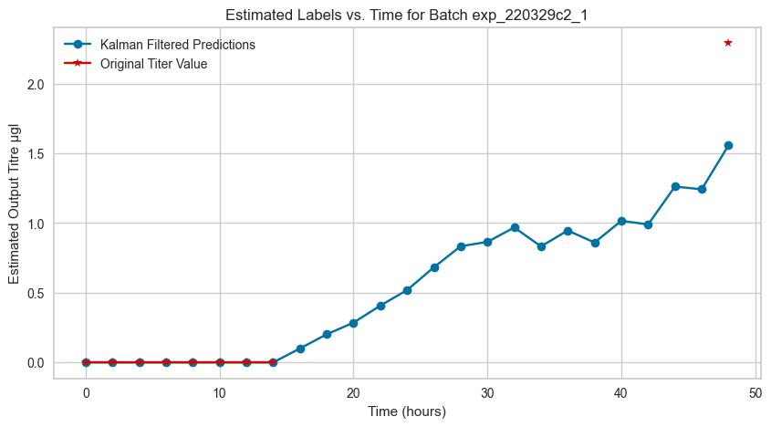
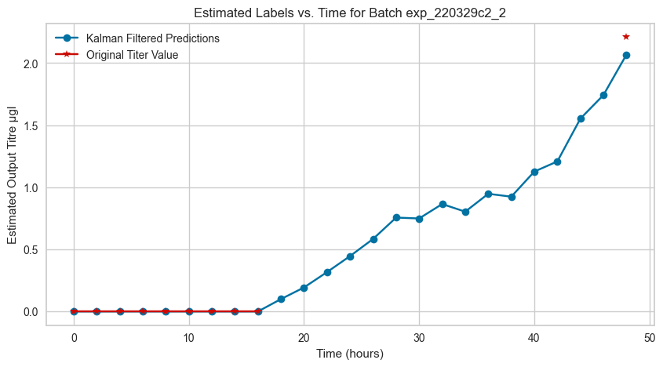
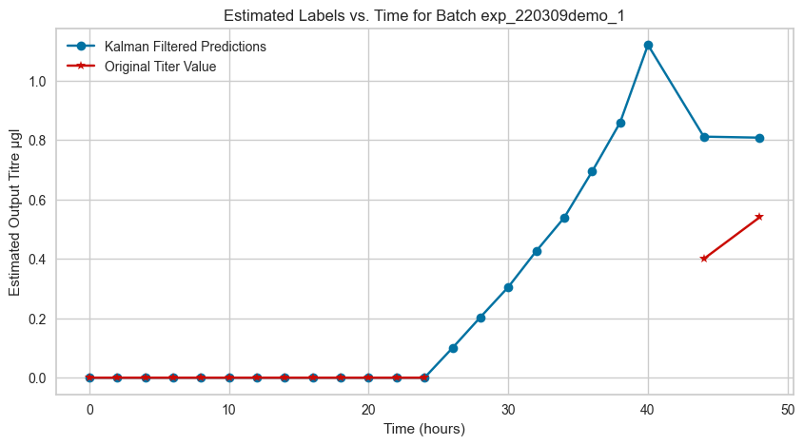
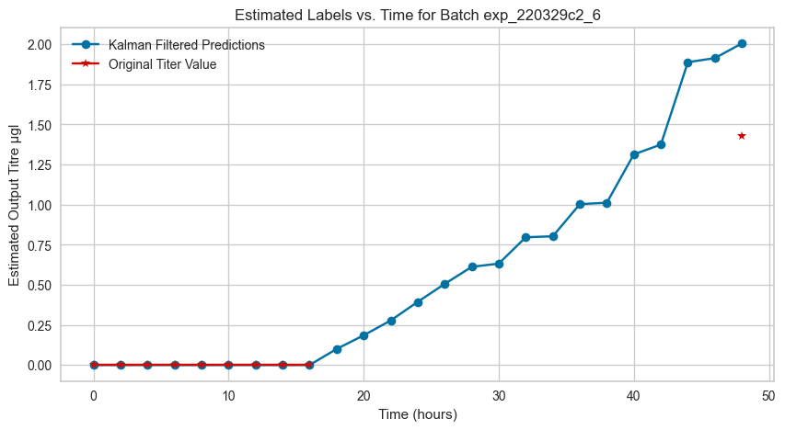
Results from Kalman Filter Imputation

Slide 20
Future Direction

Slide 21
Future Direction
Explore Alternative Filter Methods
Investigate and compare various filtering techniques.
Aim to enhance model robustness and data noise handling.
Implement Transfer Learning
Apply transfer learning to titer imputation.
Utilize datasets from Cytovance Biologics CHO Titer Experiment Analysis.

Slide 22

Thank you!

